Slide 1
Core Java
By
Gourav Govande

Slide 2
Overview
Introduction and History
Principles of Java
Difference - JDK, JRE, JVM and JIT
Execution Of Java Program
Class and ClassPath

Slide 3
Introduction and history
James Gosling and Sun Microsystems started
Oak 1991
Java, May 20, 1995, Sun World
HotJava
JDK Evolutions
J2SE, J2ME, and J2EE

Slide 4
Principles of Java
Object and Class
Abstraction
Encapsulation
Inheritance
Polymorphism

Slide 5
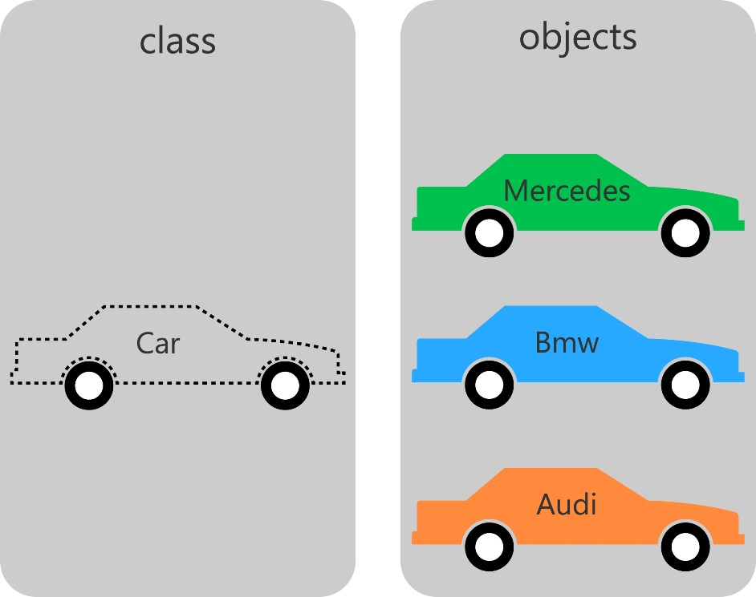
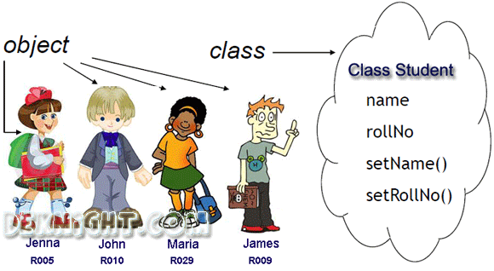
Object and class

Slide 6
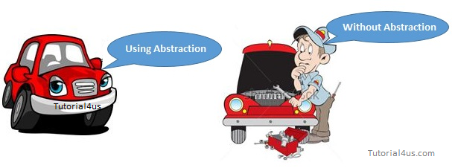
Abstraction

Slide 7
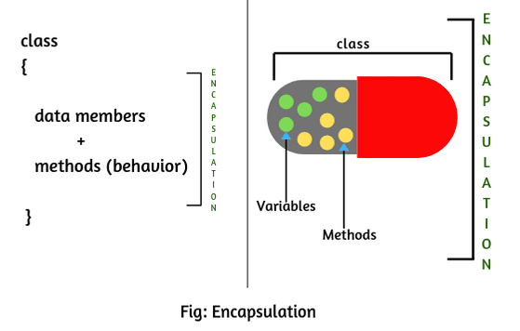
Encapsulation

Slide 8
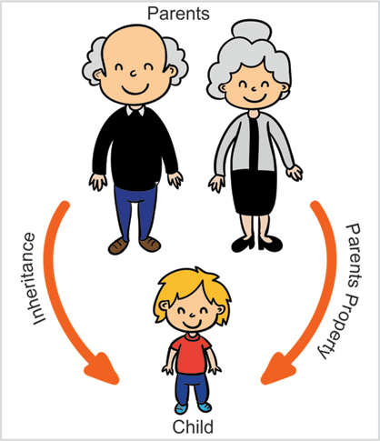
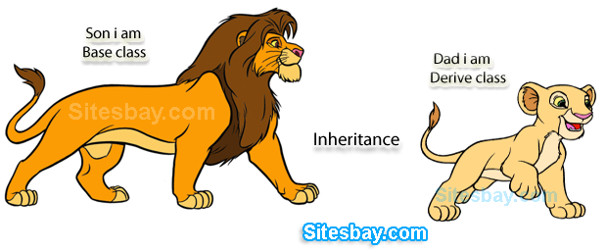
Inheritance

Slide 9
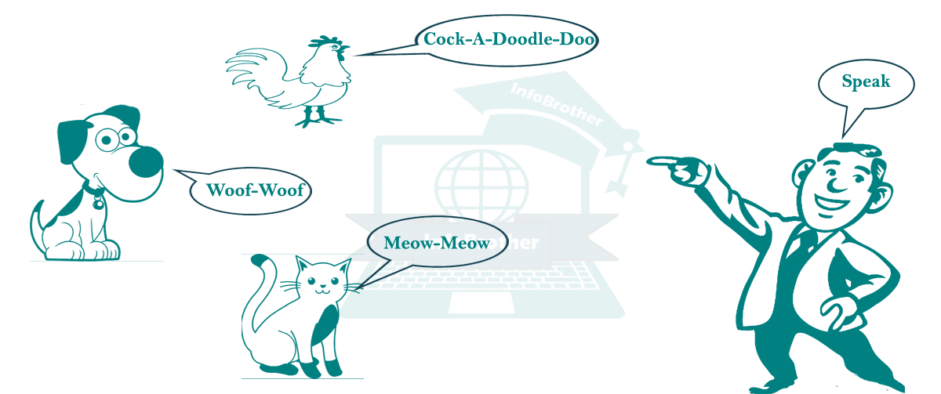
Polymorphism

Slide 10
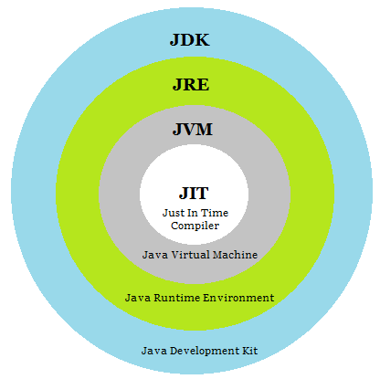
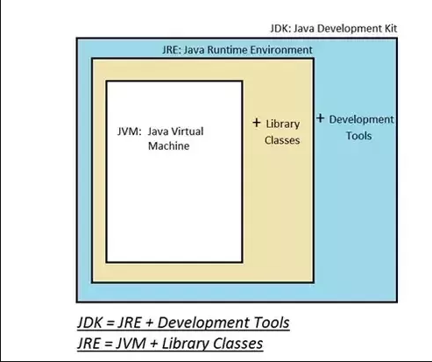
Difference - jdk, jre, jvm and jit

Slide 11
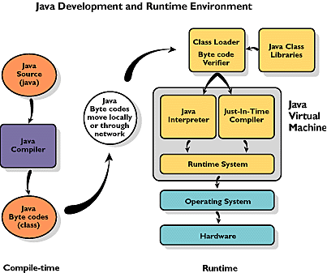
Execution of Java program
Why is Java Secure?

Slide 12
Path and classpath
PATH
Path represents where binary executable files are available. E.g. JAVAC.exe
CLASSPATH
CLASSPATH describes the location where required .class files are located
JAVAC compiles and JVM will use it.

Slide 13
Path and classpath
Set environment variable
JAVA_HOME = “usr/lib/jvm/java_<version>_jdk”
export JAVA_HOME
export PATH=$PATH:$JAVA_HOME/bin

